Slide 1



s
e
c
o
n
d
C
O
R
N
A
N
I
T
H
I
S
1.12-24
A free CD of this message will be available following the service
It will also be available for podcast later this week at calvaryokc.com

Slide 2
2 Cor. 1.3 – Blessed be the God and Father of our Lord Jesus Christ, the Father of mercies and God of all comfort,
O
A
N
S
1.12-24
I
I
s
e
c
o
n
d
C
R
N
T
H

Slide 3
O
A
N
S
1.12-24
I
I
s
e
c
o
n
d
C
R
N
T
H

Slide 4
sincerity – heilikrineia – sun-judged
hēlios – the sun, or the sun’s ray
krinō – to determine judiciously, to judge
O
A
N
S
1.12-24
I
I
s
e
c
o
n
d
C
R
N
T
H

Slide 5



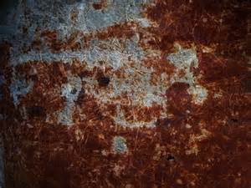
Legalism
Godly sincerity
Shallowness
O
A
N
S
1.12-24
I
I
s
e
c
o
n
d
C
R
N
T
H

Slide 6
O
A
N
S
1.12-24
I
I
s
e
c
o
n
d
C
R
N
T
H

Slide 7
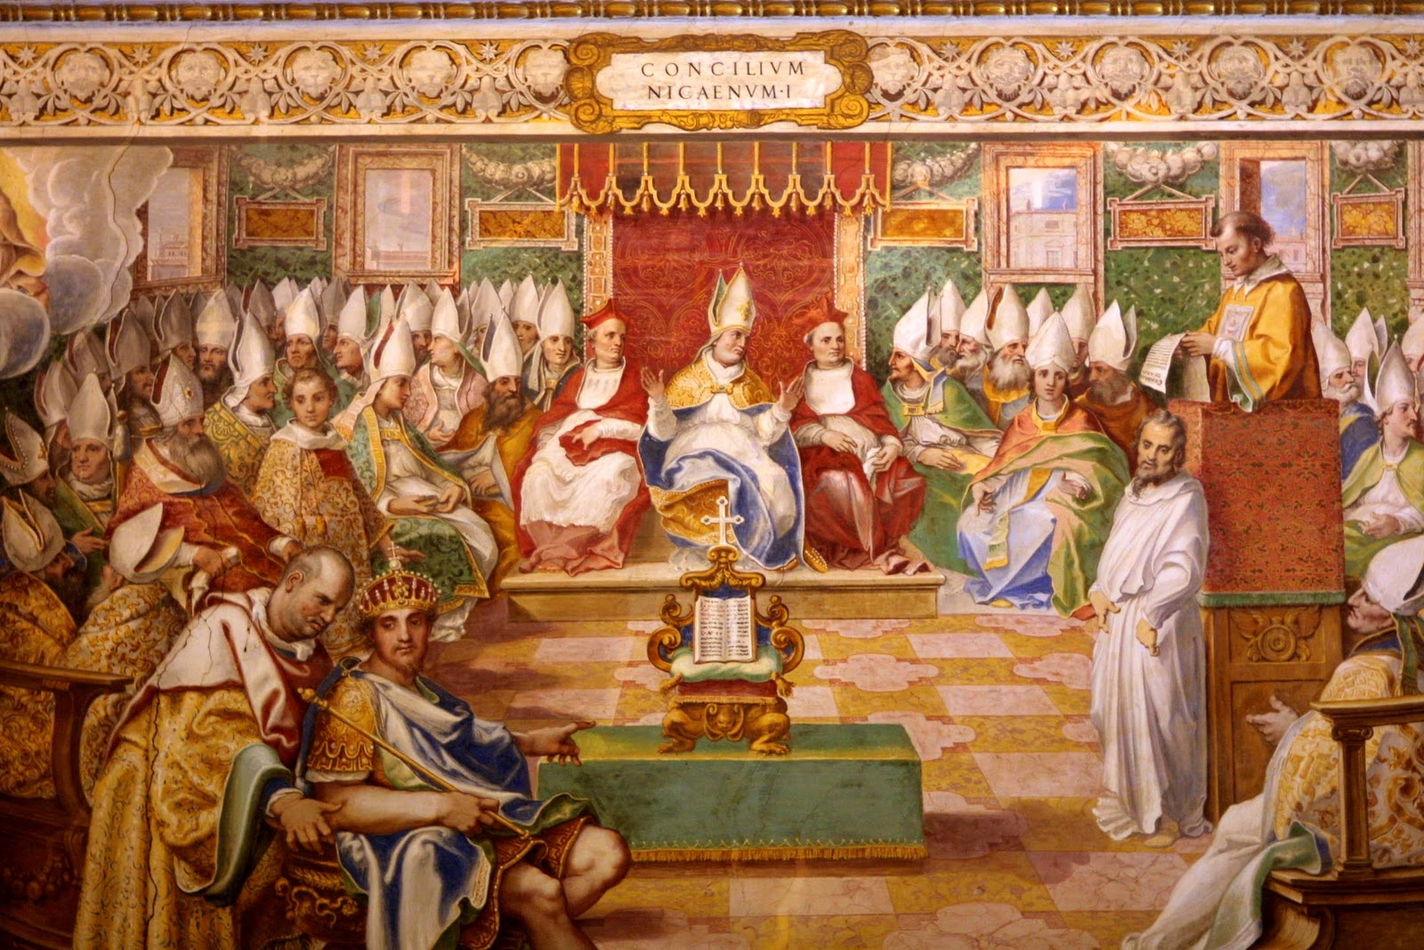
1st Council of Nicaea, AD 325
Constantine changed sabbath from Saturday to Sunday
That He determined New Testament canon
That He declared the deity of Christ, etc
O
A
N
S
1.12-24
I
I
s
e
c
o
n
d
C
R
N
T
H

Slide 8
O
A
N
S
1.12-24
I
I
s
e
c
o
n
d
C
R
N
T
H

Slide 9
Silvanus – alternate for Silas (NLT, NIV)
O
A
N
S
1.12-24
I
I
s
e
c
o
n
d
C
R
N
T
H

Slide 10
O
A
N
S
1.12-24
I
I
s
e
c
o
n
d
C
R
N
T
H

Slide 11
Eph. 1:13-14 – ¹³ In Him you also trusted, after you heard the word of truth, the gospel of your salvation; in whom also, having believed, you were sealed with the Holy Spirit of promise, ¹⁴ who is the guarantee of our inheritance until the redemption of the purchased possession, to the praise of His glory.
O
A
N
S
1.12-24
I
I
s
e
c
o
n
d
C
R
N
T
H

Slide 12
O
A
N
S
1.12-24
I
I
s
e
c
o
n
d
C
R
N
T
H

Slide 13
Eph. 4.30 – And do not grieve the Holy Spirit of God, by whom you were sealed for the day of redemption.
O
A
N
S
1.12-24
I
I
s
e
c
o
n
d
C
R
N
T
H

Slide 14
O
A
N
S
1.12-24
I
I
s
e
c
o
n
d
C
R
N
T
H

Slide 15
1 Pet. 5.2-3 – ² Shepherd the flock of God which is among you, serving as overseers, not by compulsion but willingly, not for dishonest gain but eagerly; ³ nor as being lords over those entrusted to you, but being examples to the flock;
entrusted – klēros – clergy
O
A
N
S
1.12-24
I
I
s
e
c
o
n
d
C
R
N
T
H

Slide 16
O
A
N
S
1.12-24
I
I
s
e
c
o
n
d
C
R
N
T
H

